Slide 1

Long-Term Ecological Research

Slide 2

Background and Past Activities
Activities 2007-2008
  Duane Costa – search term usage
  John Porter – LTER words and the NBII Thesaurus
Discussion
  Possible partners
  Leveraging the search term archive
Planning for the IM meeting

Slide 3

For past activities, see the report at: http://intranet.lternet.edu/im/node/114 and http://intranet.lternet.edu/archives/documents/Newsletters/DataBits/06spring/
Summary:
  Eclectic keywords make searching difficult
  No easy way to group or organize similar datasets to facilitate “browse” searches
  Past products of the working group included an ordered list of commonly-used LTER words from Datasets and Publications – See: http://cvs.lternet.edu/cgi-bin/viewcvs.cgi/*checkout*/NIS/projects/controlledVocabulary/lterTerms/Keyword_summary1.xls?rev=1.1&content-type=application/vnd.ms-excel

Slide 4

Duane Costa – Search Terms
LTER words and the NBII Biocomplexity Thesaurus

Slide 5

Giri Palanisamy of ORNL DAAC wrote a program to test whether each of the LTER words and multi-word terms were found in the NBII thesaurus. If so, how many
  Broader
  Narrower
  Related
  terms were found

Slide 6
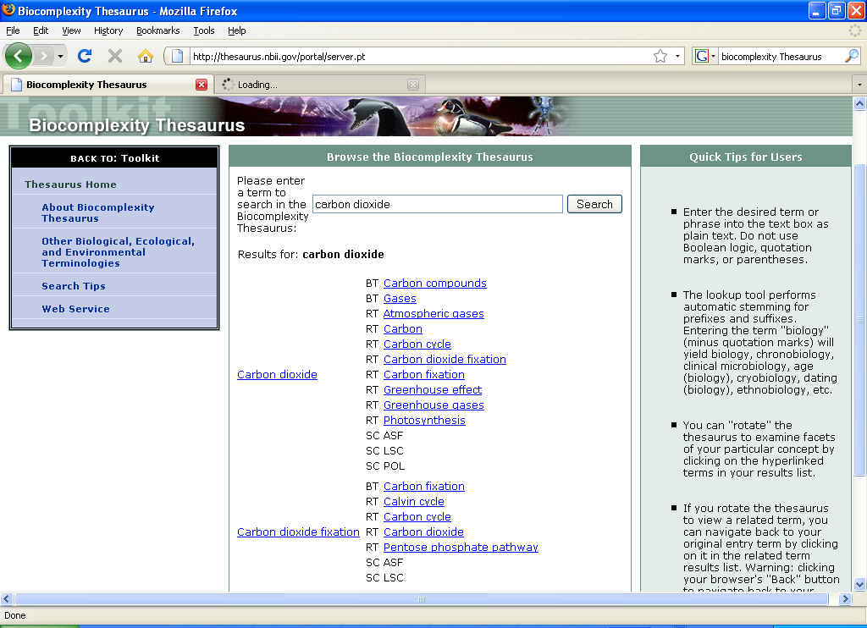


Slide 7
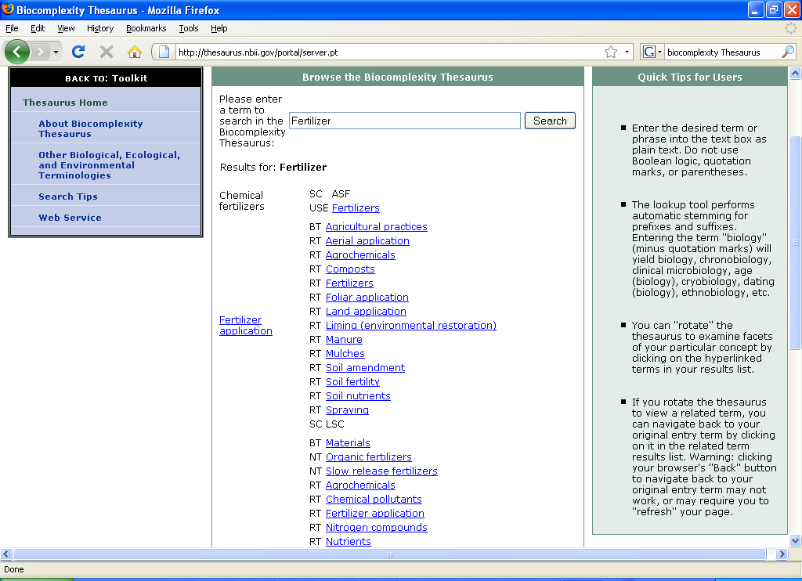

Slide 8
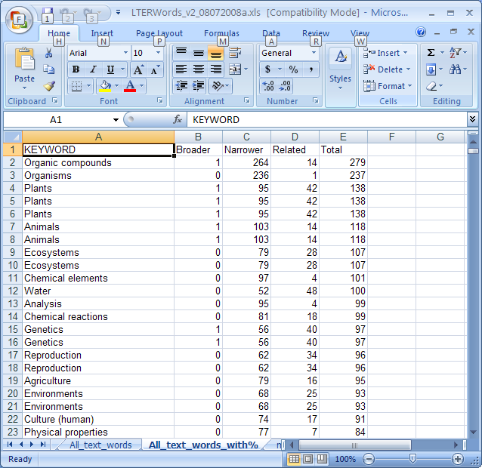
Combined LTER single-word keyword and multiword keyword lists.
Note some words are duplicated (but get identical results)

Slide 9

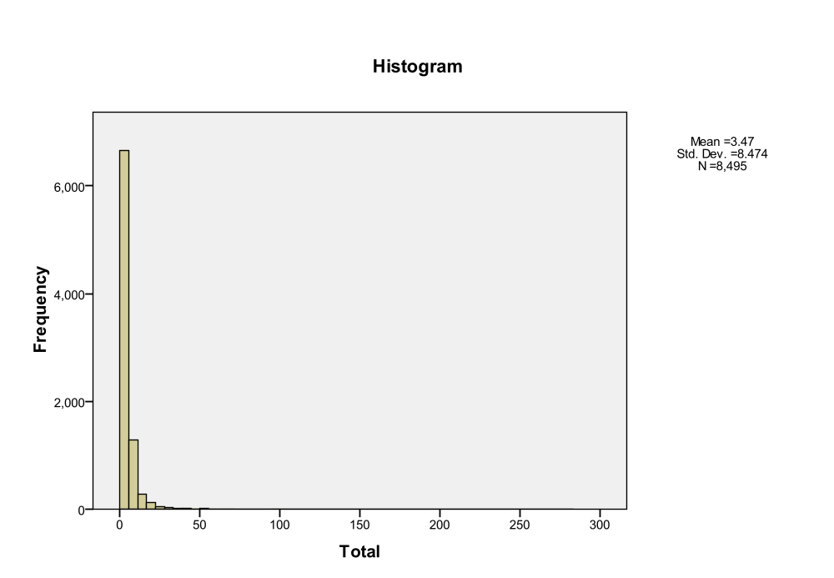
With duplicates removed
58% “misses”, 42% had one or more “hits”
“Best” keyword had 279 hits
Even with “misses” included there were an average of 3.5 hits per word

Slide 10

n Min Max Sum Mean Std. Dev.
Broader 8494 0 12 7090 .83 1.379
Narrower 8494 0 264 7391 .87 6.289
Related 8494 0 48 15011 1.77 3.592
Total 8495 0 279 29492 3.47 8.474
Over 29,000 terms of additional context provided, mostly related terms

Slide 11

Develop ideas for tools that can help us to use this extra context
Explore with NBII the addition of more of the LTER keywords to their thesaurus
Explore other Thesauri and ontologies to see if any others match better to the LTER datasets

Slide 12

NBII Biocomplexity Thesaurus – public domain - http://thesaurus.nbii.gov/portal/community/Communities/Toolkit/Biocomplexity_Thesaurus/
GEMET – multilingual, proprietary - http://www.eionet.europa.eu/gemet
AGROVOC – multilingual, proprietary, Web services interface - http://www.fao.org/aims/ag_intro.htm

Slide 13

How can we best leverage the resources we’ve assembled?
  Search Term Archive
  LTER Word List(s)
  Links to NBII Thesaurus
Are their activities we should pursue at the IM and EIMC meeting?

